Slide 1
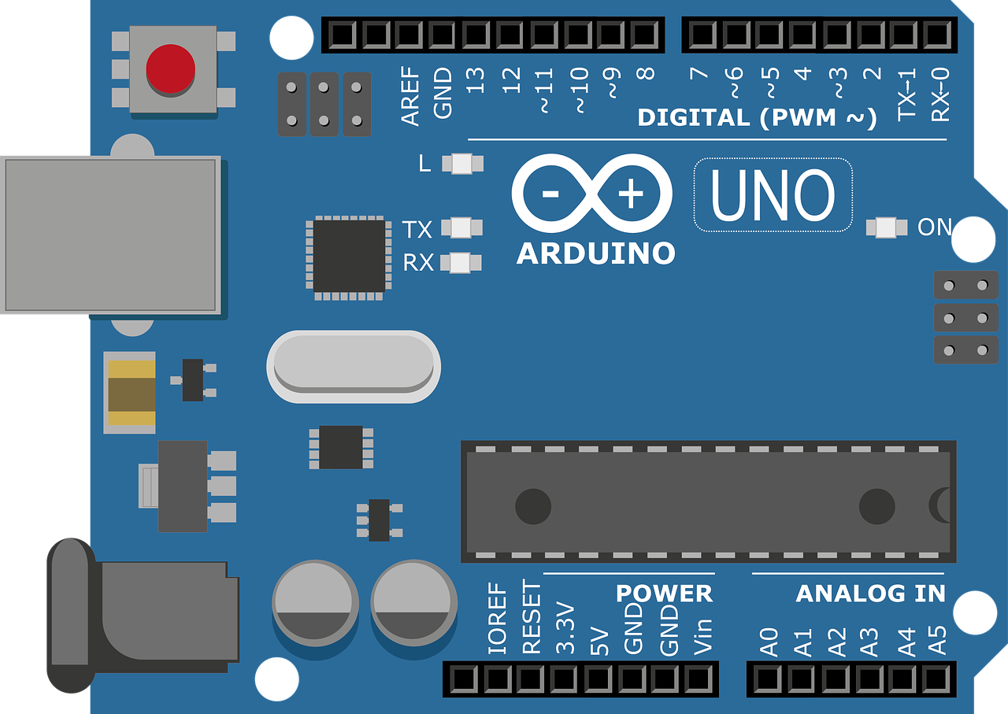
Exmaple 7
Smart Irrigation System

Slide 2
Arduino Overview and Programming Guide
Why Use Arduino?
Arduino is an easy-to-use electronics platform that is suitable for all skill levels, and it offers the following benefits:
Easy to Use: Designed for both beginners and professionals.
Open Source: Both hardware and software are open-source, meaning anyone can use and modify them.
Versatile: Can be used for a wide range of projects, from simple to complex ones.
Large Community: A large community that provides support, resources, and tutorials.
Arduino Board Components
Microcontroller: The "brain" of the board that executes the program.
Digital Pins: Used for digital input and output (HIGH or LOW).
Analog Pins: Used for reading analog signals and converting them into digital values.
Power Pins: Used to supply power to the board and external components.
Arduino Code Structure

Slide 3
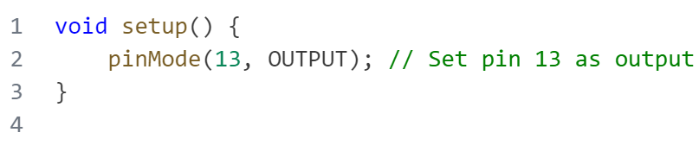
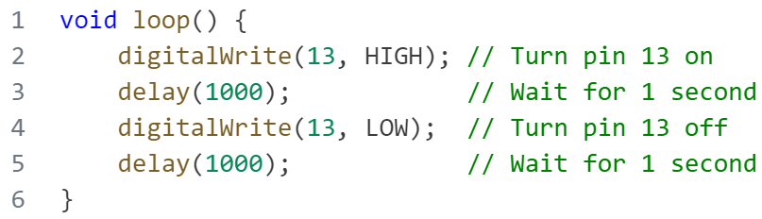
Arduino Overview and Programming Guide
Arduino Code Structure
Arduino code consists of two main functions:
setup()
Runs once at the beginning of the program.
Used to initialize the setup, such as
setting pin modes.
loop()
Runs repeatedly after the setup() function.
Contains the main tasks that the program
will perform.

Slide 4
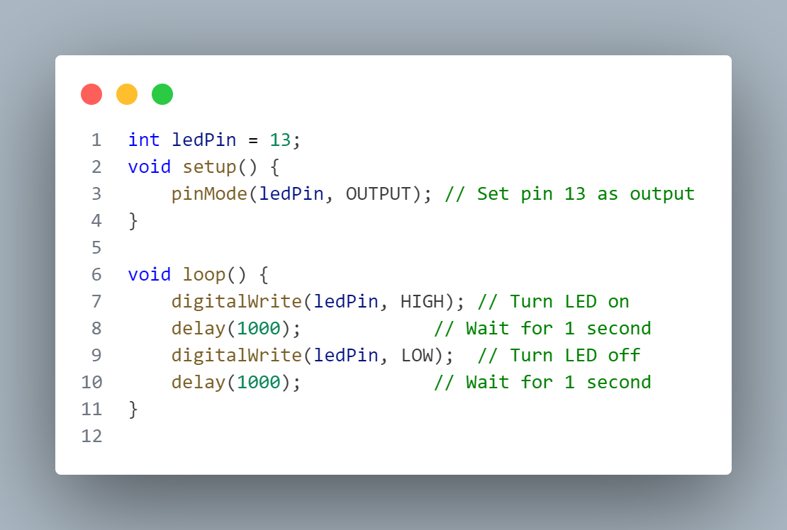
—SOMEONE FAMOUS
Arduino Overview and Programming Guide
Basic Arduino Functions
pinMode(pin, mode): Used to set the pin mode as input (INPUT) or output (OUTPUT).
digitalRead(pin): Reads the state of a digital pin (HIGH or LOW).
digitalWrite(pin, value): Sets the state of a digital pin (HIGH or LOW).
Example 1 - Blinking LED
Objective:
Make an LED blink on and off repeatedly.
Components: Arduino board – LED
Resistor (220 ohms) – Breadboard - Jumper wires.
Steps:
Connect the LED to a digital pin (pin 13)
Connect the other leg of the LED to ground (GND).
Upload the following code to the Arduino.

Slide 5
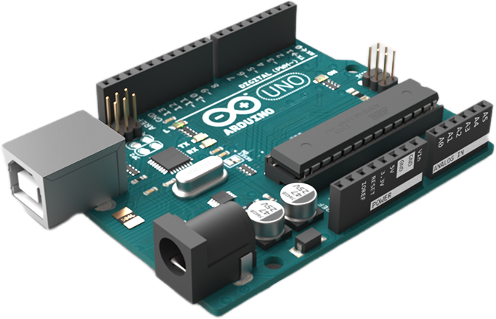
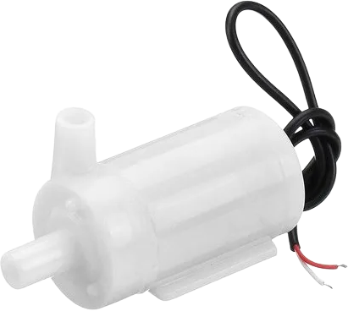
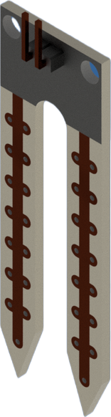
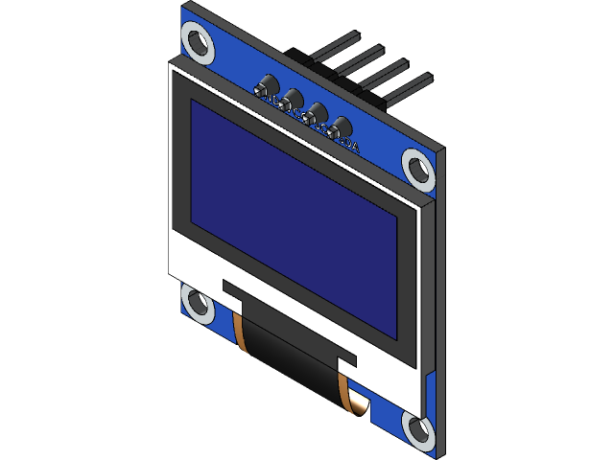
—SOMEONE FAMOUS
Project: Smart Irrigation System
This project automates watering plants based on the soil moisture level. The system uses an Arduino to read data from a soil moisture sensor and control a water pump. An OLED display provides real-time feedback about the soil moisture level and system status.
01
Arduino Uno
04
water pump
02
soil moisture sensor
05
OLED display

Slide 6
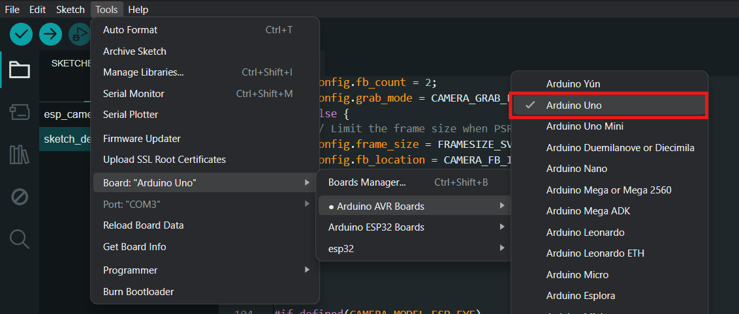
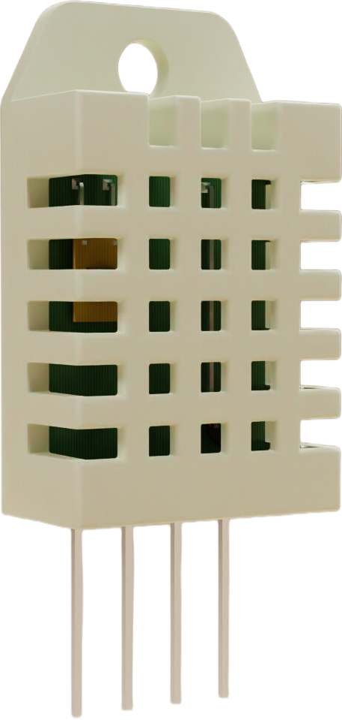
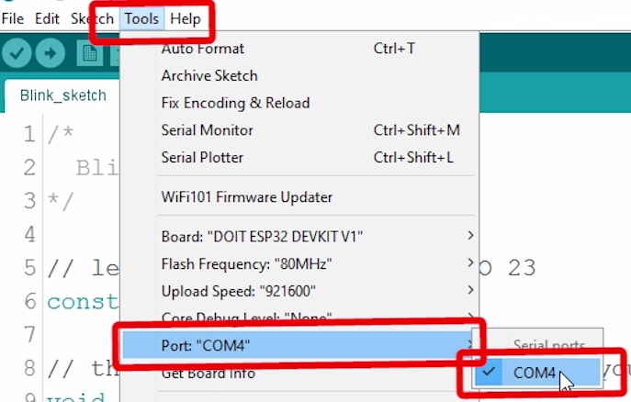
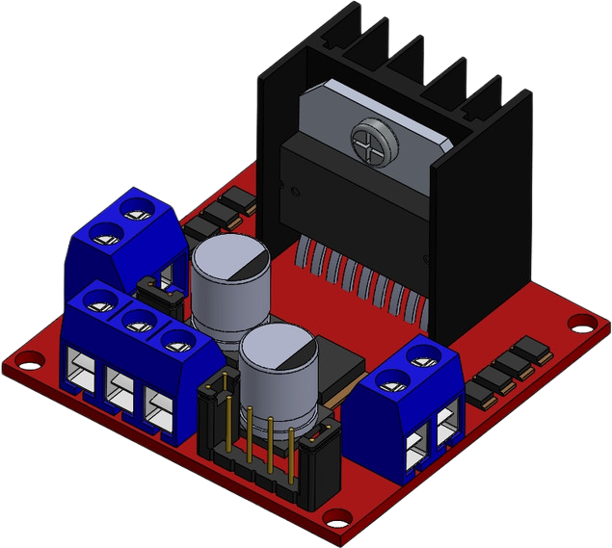
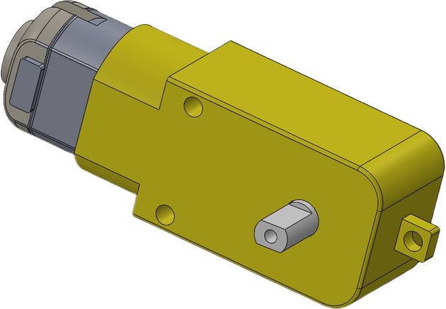
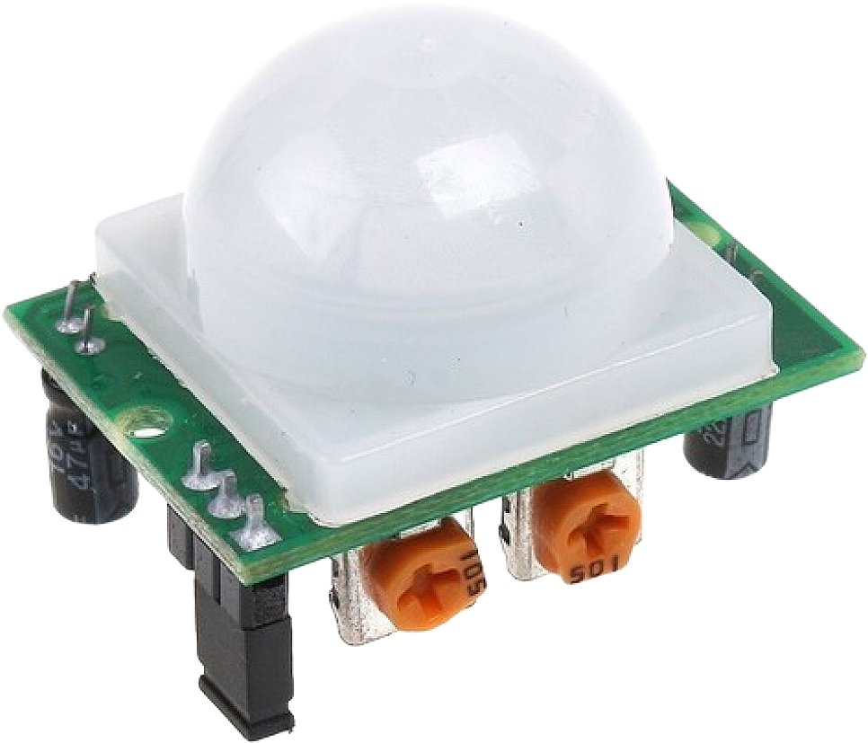
—SOMEONE FAMOUS
Project: DC Motor Control with Motion Sensor Through ESP32
01
Ardiuno Uno
In this project, we will control a DC motor based on the input from a motion sensor (PIR sensor) using an ESP32 board. When motion is detected by the PIR sensor, the DC motor will be activated, and it will stop once the motion is no longer detected.
Select your Board in Tools > Board menu
(in my case it’s the Arduino Uno)
Select the Port (if you don’t see the COM Port in your Arduino IDE, you need to install the CP210x USB to UART Bridge VCP Drivers):
04
L298N Motor Driver
02
DC Motor
05
PIR Motion Sensor

Slide 7
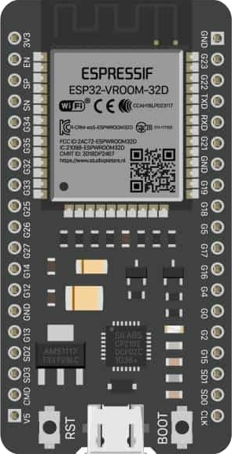
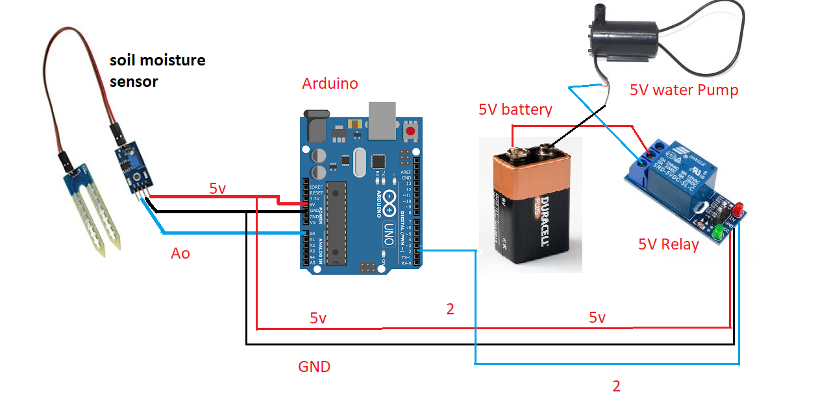
—SOMEONE FAMOUS
01
Project: DC Motor Control with Motion Sensor Through ESP32
ESP32 board
DC Motor
05
PIR Motion Sensor

Slide 8
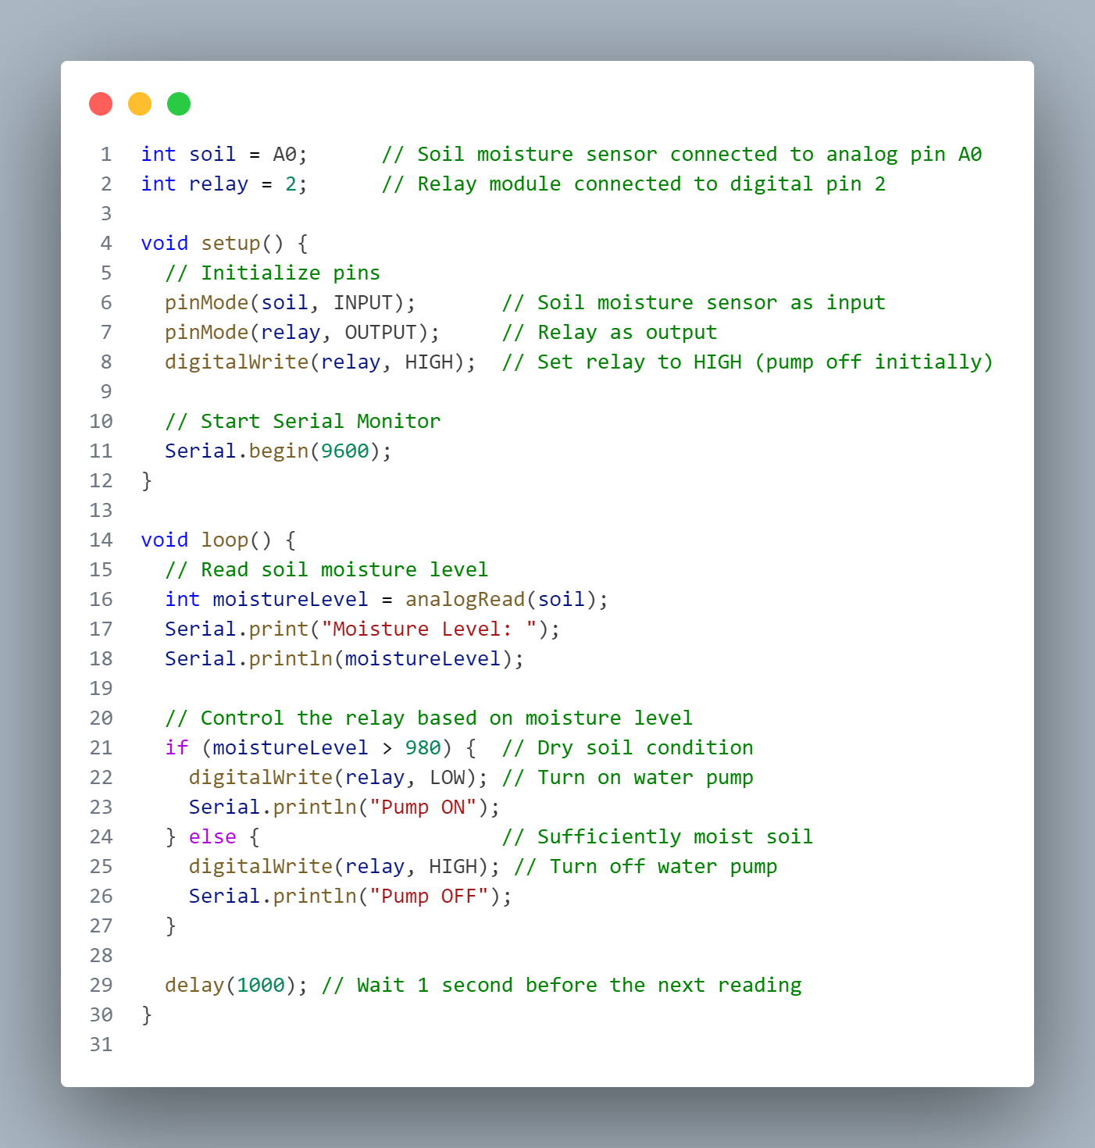
—SOMEONE FAMOUS
01
Project: DC Motor Control with Motion Sensor Through ESP32
ESP32 board
DC Motor
05
PIR Motion Sensor

Slide 9
Relational Databases
Thank You
NoSQL Databases
NoSQL (Not Only SQL) databases are
designed to handle unstructured,
semi-structured, and structured
data. They are flexible and scalable,
making them suitable for handling
large volumes of data. Examples
include:
MongoDB (document-oriented)
Cassandra (column-family)
Redis (key-value)
Elasticsearch (search-oriented)
Relational databases store data in
structured tables with rows and
columns. They use SQL (Structured
Query Language) for querying and
managing data. Examples include:
MySQL
PostgreSQL
SQLite
Microsoft SQL Server
Oracle Database

